Slide 1

Walmart Sales analysis
Ajay Thakur (1st May Batch)
Video Link : https://www.loom.com/share/b49e4a8e2edd43e2b44e1734a8149696?sid=a7954d10-e367-4eb7-98b1-fd483db041b7 Project Link : https://github.com/ajaythakur958/Walmart-Sales-analysis

Slide 2
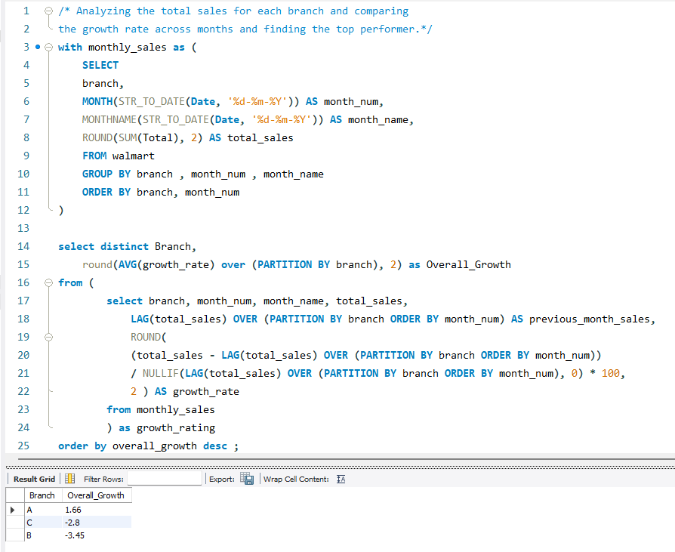
Identifying the Top Branch by Sales Growth Rate
INSIGHTS
Branch A is the only one showing positive average sales growth of +1.66%
Branch C shows a decline of -2.80%, indicating unstable or falling sales despite being centrally positioned alphabetically
Branch B has the worst performance with -3.45% average growth, suggesting a strong need for intervention.
RECOMMENDATIONS
Analyze strategies used in Branch A (promotions, local demand, staff efficiency) and consider replicating them in Branches B and C for better output.
Implement targeted marketing campaigns or seasonal offers in underperforming branches to boost engagement and revenue.

Slide 3
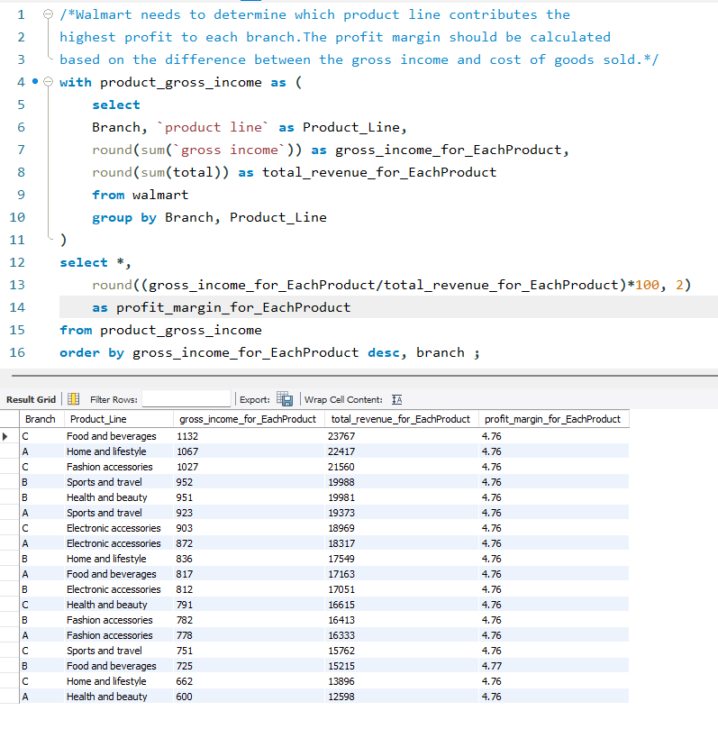
Finding the Most Profitable Product Line for Each Branch
INSIGHTS
The profit margin for all branches and all product lines is exactly same as 4.76%.
This is because in the dataset, Gross Income is fixed at 5% of Totals Same as TAX 5%, which means with formula :
Gross Income ⇒ (Gross Income/total revenue) * 100⇒ Profit Margin gives≈ 5%
However, gross income varies across branches and product lines:
Food and Beverage in Branch C generated the highest gross income (1132), followed by Home and LifeStyle and Fashion accessories in other branches.
RECOMMENDATIONS
Focus on product lines like Food and Beverage, Home and Lifestyle, and Fashion Accessories, which bring the highest gross income..
Promote best-performing categories based on gross income instead of margin.

Slide 4
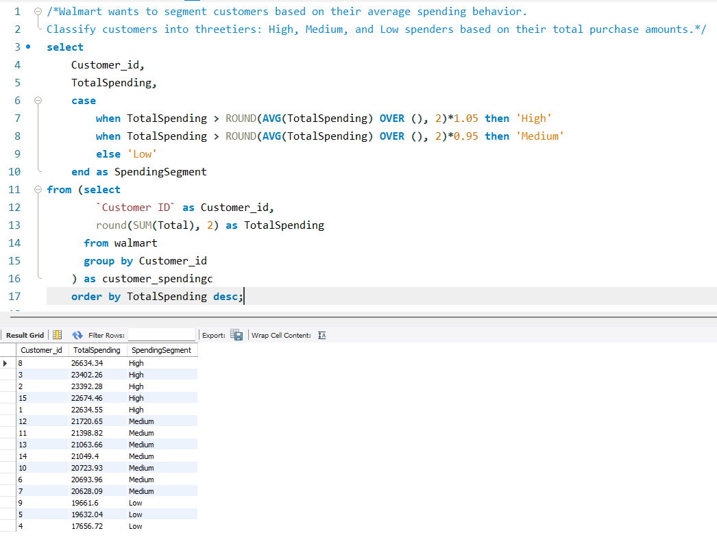
Analyzing Customer Segmentation Based on Spending
INSIGHTS
Customers have been classified into High, Medium, and Low spending segments using total purchase value .
High Spenders: Customers with spending above 105%.
Medium Spenders: Customers between average (95% - 105%).
Low Spenders: Significantly below average ( under 95%).
Most customers fall under Medium and Low segments, while few are High spenders—Contribute a significant share of total revenue, exceeding ₹23,000+ (Customer ID 8 ,3 and 2 with highest ).
RECOMMENDATIONS
Customers with high spends—Retain them through loyalty rewards, exclusive offers, and early sale access to boost long-term engagement.
Medium Spenders (Potential high spenders). Offer them tier-up discounts or cashback on larger orders to motivate higher purchases.
For Low Spenders Sending targeted engagement emails, reminders, or low-budget bundle deals to bring them back into the buying cycle

Slide 5
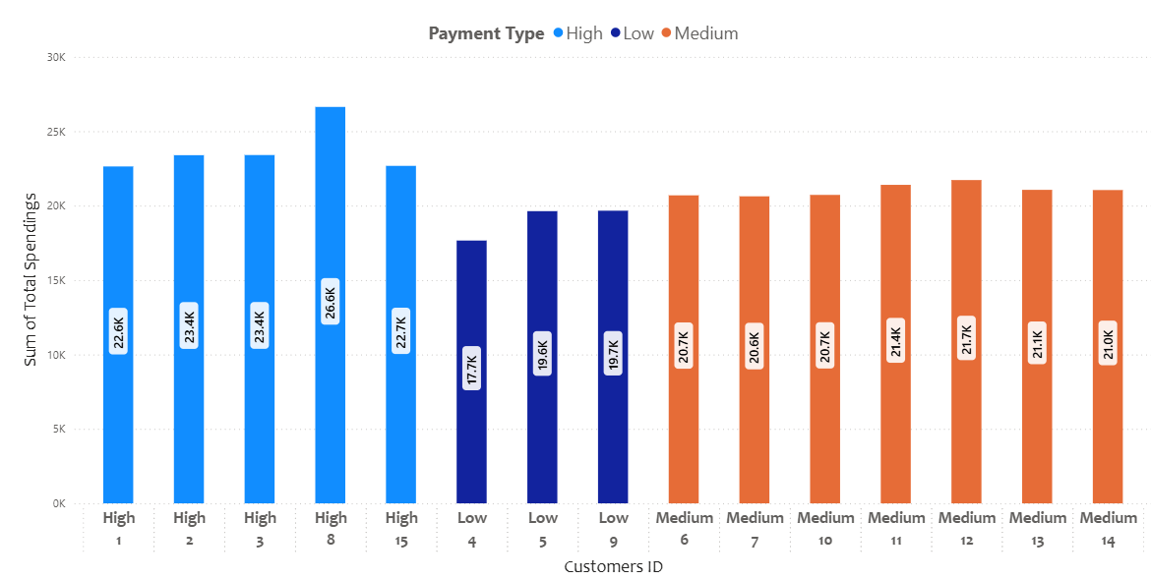
Customer Segmentation Based on Spending

Slide 6
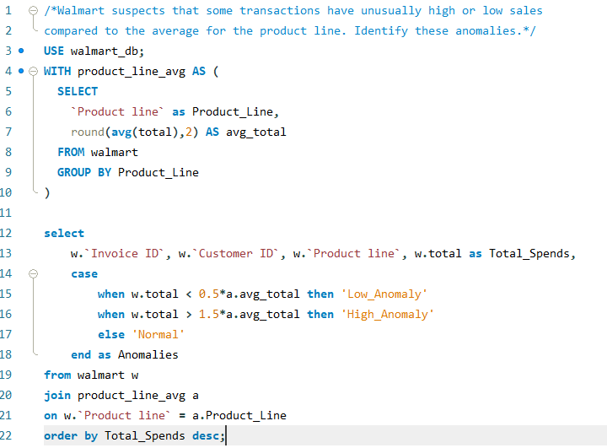
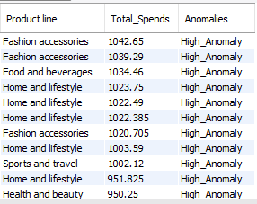
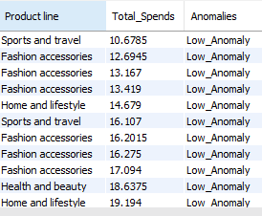
Detecting Anomalies in Sales Transactions
INSIGHTS
Some transactions in the “Sports and travel and” and “Fashion accessories " product line show extremely as low (₹10) or high as (₹1000+)
Normal Anomalies lies under range between 200 to 400 (Average of Total spend)
Customers like High Spenders, possibly indicating bulk purchases or loyal, high-value buyers.
RECOMMENDATIONS
Offer loyalty programs or premium services to customers with consistently high spends to retain them.
Create custom offers for customers with lower-than-average purchases to boost their spend, potentially shifting them into the normal or high-spend segment
Descending order Result
Ascending order Result

Slide 7
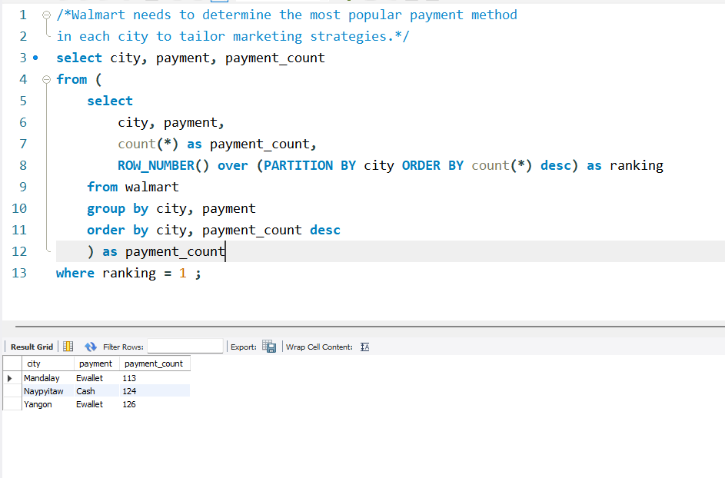
Analyzing Customer Segmentation Based on Spending
INSIGHTS
Yangon & Mandalay: Most preferred payment method is Ewallet with 126 and 113 purchases respectively.
Naypyitaw: Prefers Cash the most with 124 purchases via cash.
RECOMMENDATIONS
Promote Ewallet offers in Yangon and Mandalay.
Run cash-based promotions in Naypyitaw.

Slide 8
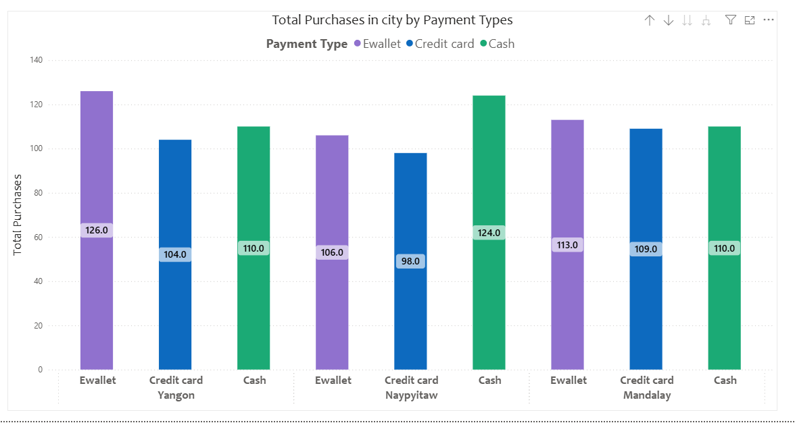
Customer Segmentation Based on Spending

Slide 9
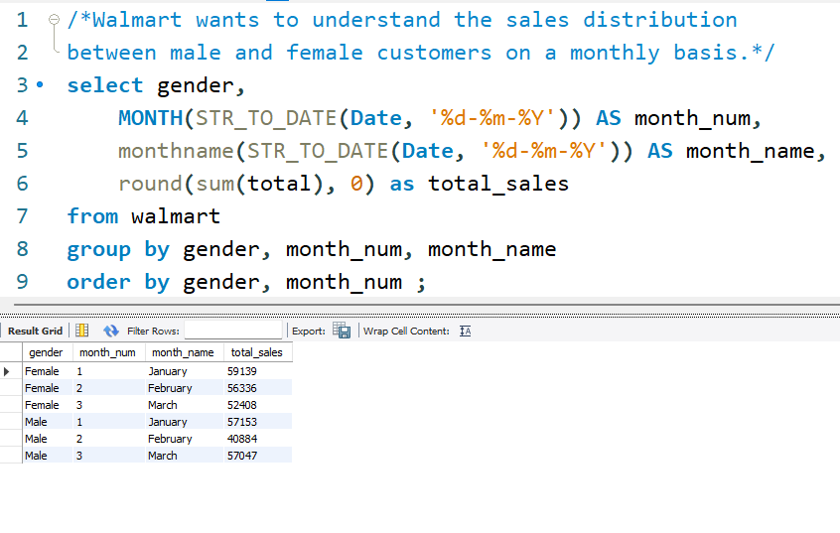
Monthly Sales Distribution by Gender
INSIGHTS
Female customers generated higher total sales across all months except March
Male customers outspent female customers in March.
Male sales showed a notable recovery in March after a dip in February.
February Month with the Largest Gender Gap in Sales between Male and Female Customers
RECOMMENDATIONS
Focus marketing campaigns more on female customers, especially in February.
Investigate underlying factors for male spending surge in March and consider applying relevant strategies to other months like February.

Slide 10
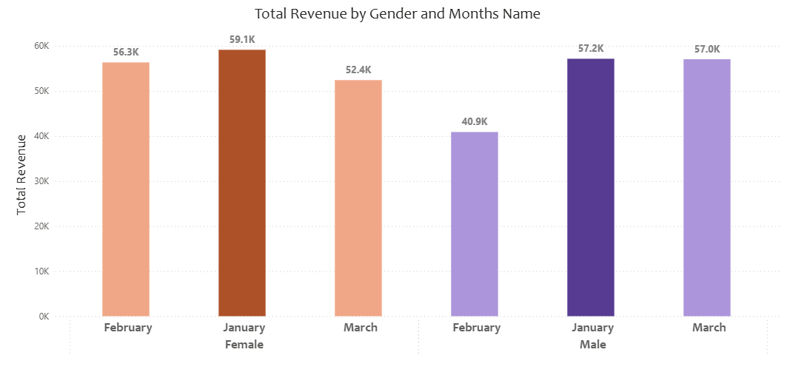
Monthly Sales Distribution by Gender

Slide 11
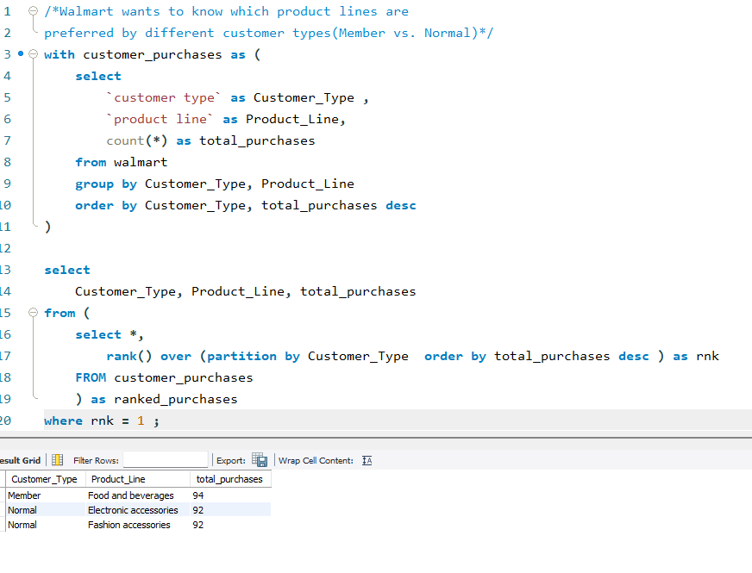
Best Product Line by Customer Type
INSIGHTS
Members prefer Food and Beverages the most (94 purchases).
Normal customers equally prefer:
Electronic Accessories (92 purchases)
Fashion Accessories (92 purchases)
RECOMMENDATIONS
Promote Food & Beverages deals to Members via loyalty rewards or exclusive offers..
Target Normal customers with bundled deals or discounts on Electronic and Fashion Accessories to boost engagement.

Slide 12
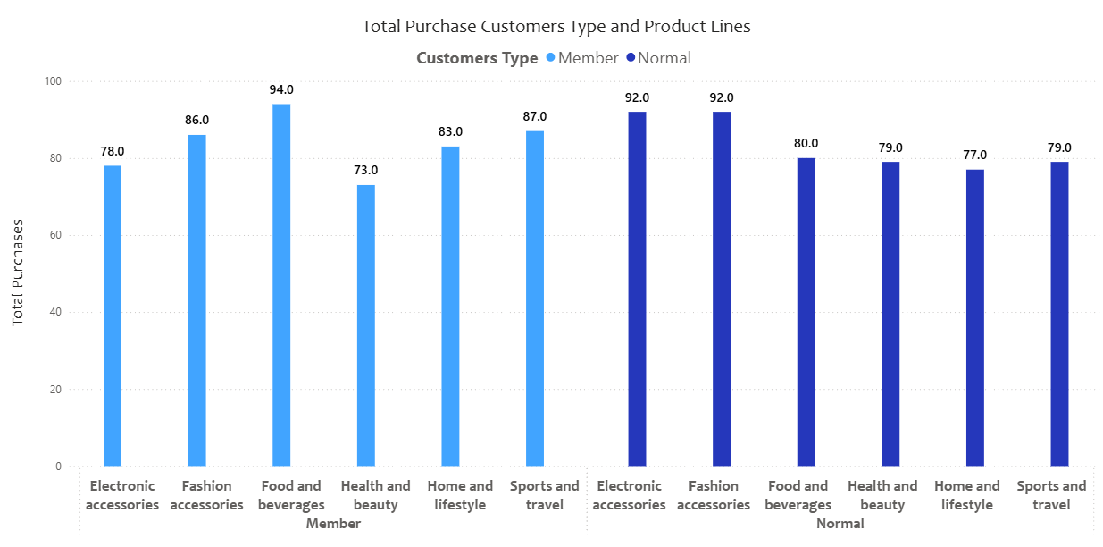
Product Line by Customer Type

Slide 13
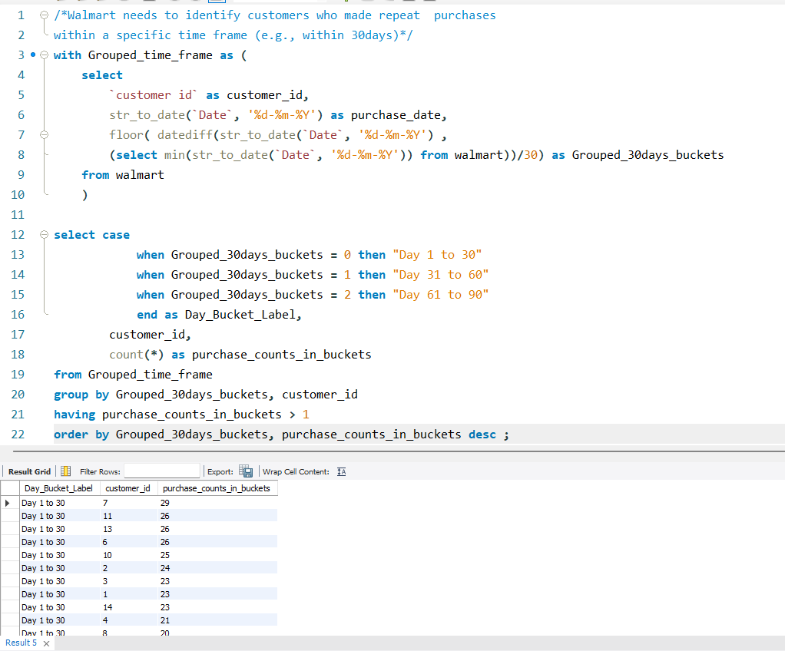
Identifying Repeat Customers
INSIGHTS
In the first 30 days, customer ID 7 was the highest repeat customer.
In the next 30 days (Day 31 to 60), customer ID 1 became the most frequent customer
In the final 30 days (Day 61 to 90), customer ID 4 was the top repeat customer.
RECOMMENDATIONS
Reward the most frequent customers with exclusive offers as a token of appreciation.
For less frequent customers, check what they bought earlier and send recommendations or similar product suggestions.

Slide 14
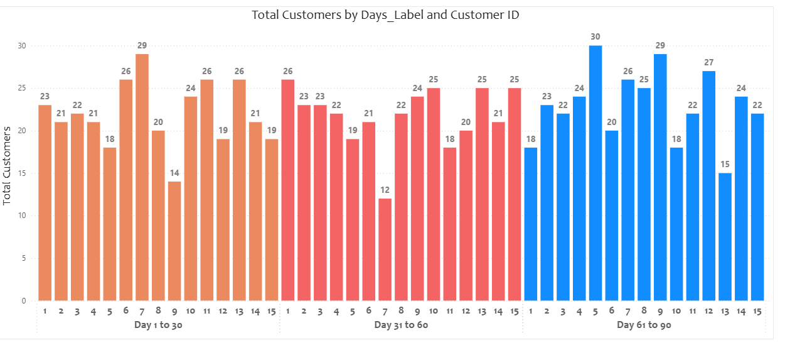
Repeated Customers in 30 Days

Slide 15
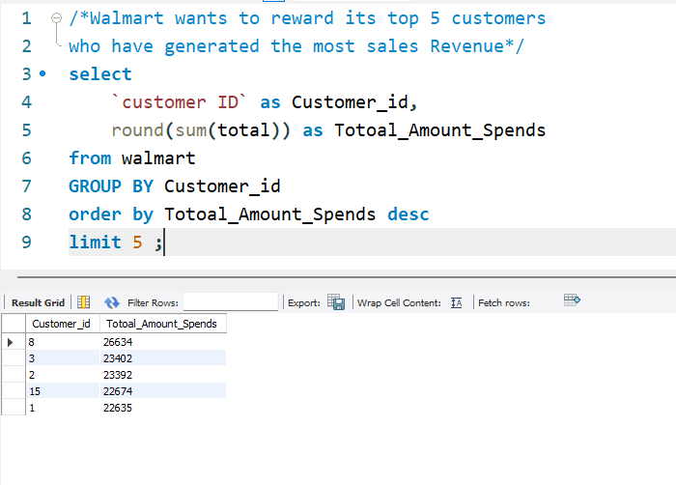
Finding Top 5 Customers by Sales Volume
INSIGHTS
Top 5 high-spending customers identified.
Customer ID 8 is the highest spender with ₹26,634 in total revenue.
All top 5 customers spent above ₹22,600, indicating strong loyalty and purchasing power.
RECOMMENDATIONS
Rewarding these top 5 customers may includes like vouchers, cashback, or premium memberships.

Slide 16
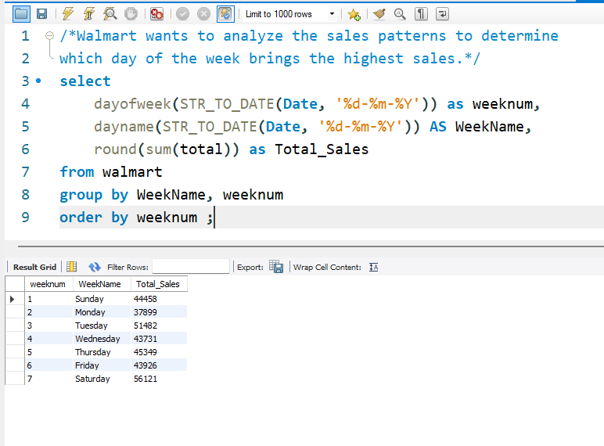
Analyzing Sales Trends by Day of the Week
INSIGHTS
Saturday generates the highest sales (₹56,121). Dip again on Sunday(₹ 44458)
Monday has the lowest sales (₹37,899).
Overall, weekends and early weekdays perform better than mid-week.
RECOMMENDATIONS
Run promotional campaigns or product launches on Saturdays to maximize revenue.
Consider offering special deals or discounts on Mondays and Midweek Wednesday-Friday to boost slow sales.

Slide 17
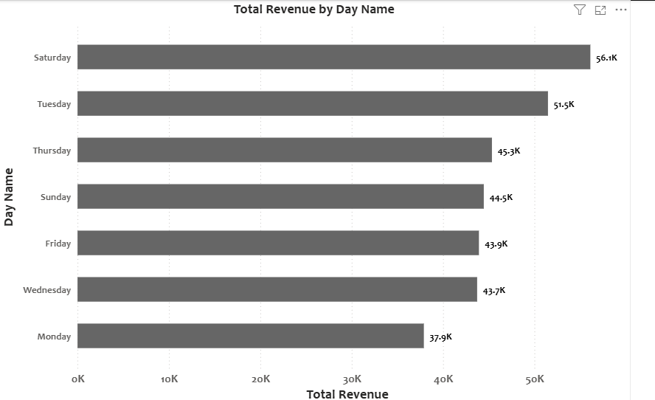
Total Revenue in Week Days

